Slide 1


FDA Inspection Analysis
Group -11
Anish. G. Kaushik
Sadanand Goud Karre
Dhanthu Deekshitha Boora
Sahasree Vemula
Nagavikas Jinkala

Slide 2

FDA Data Analysis Project
The FDA (Food and Drug Administration) is a U.S. government agency responsible for protecting public health.
It ensures safety and efficacy of food, drugs, medical devices, and cosmetics.
Conducts inspections and enforces regulations across various sectors.
Plays a key role in preventing public health risks and ensuring consumer safety.
Notes:
What do you know about the FDA? The Food and Drug Administration (FDA) is a United States federal organization in charge of ensuring the safety and efficacy of food, pharmaceuticals, medical devices, and other products. It conducts inspections and enforces regulations to protect public health.Compliance and Enforcement: Conducts inspections, sends warning letters, and may take legal action against corporations that violate FDA regulations.Helps prevent public health concerns and ensures consumer safety.The FDA also plays an important role in the approval process for new products, ensuring that they meet stringent requirements before they access the market. This includes reviewing clinical trial results for new pharmaceuticals and medical devices to ensure their safety, efficacy, and quality. Furthermore, the FDA conducts post-market surveillance to ensure the safety of products after they have been used, responding rapidly to emergent issues or adverse events. By encouraging innovation and maintaining tight regulatory control, the FDA not only protects public health but also contributes to consumer trust in the products they use on a daily basis.

Slide 3
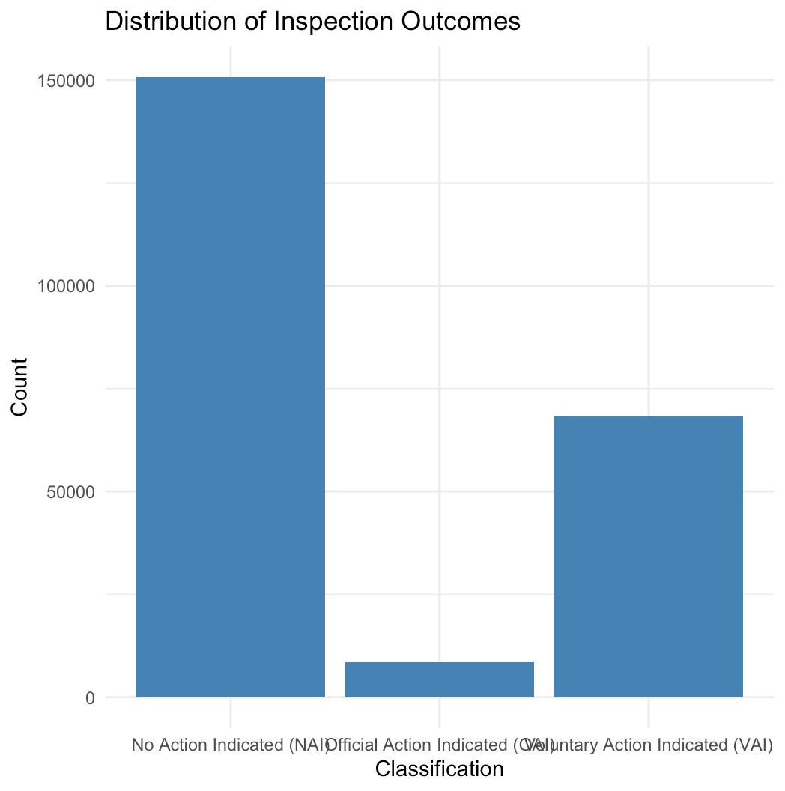

Agenda & Objective of the Analysis
What are the most important factors influencing FDA inspection outcomes?
Which facilities are at the highest risk of failing an inspection, and why?
How should we categorize FDA-inspected facilities into meaningful groups based on inspection history?
Predictive Modeling
Clustering
Risk Profiling
Optimization
Notes:
The objective to undertsnd the data is to address the questions(slide).
We did Predictive Modeling
Clustering
Risk Profiling
Optimization, to get accurate results for the questions above

Slide 4

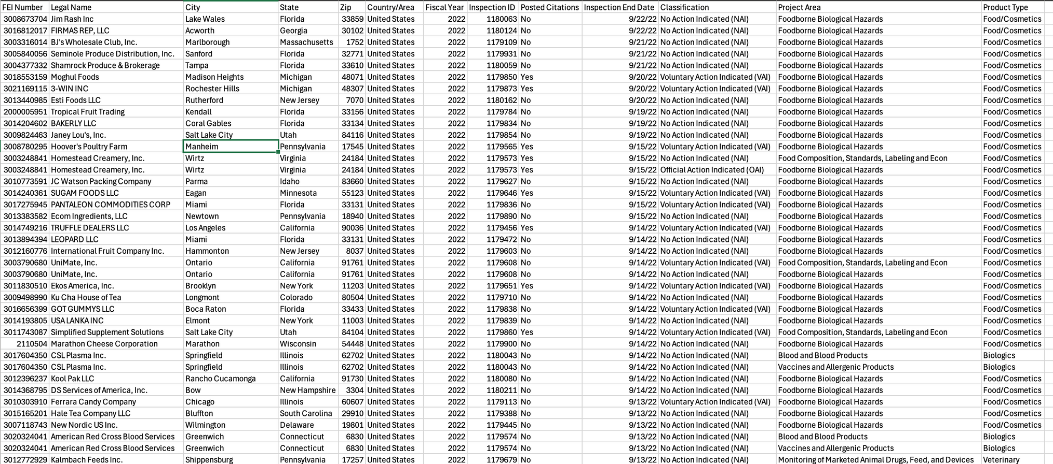
Understanding the Data
Data trend evaluation
Analyzing trends in FDA data.
Notes:
Understanding these features helps us know what kind of analysis we can do. For example, categorical data like State or Classification will likely require encoding before feeding them into a machine learning model, while numerical data like Inspection End Date will be treated differently in the analysis process."
"In this project, we will focus on analyzing patterns in inspection outcomes, identifying factors that contribute to certain outcomes like OAI or NAI, and building predictive models. So, recognizing the structure of the dataset helps us decide what features to prioritize."
With this understanding of the dataset's structure,
The dataset includes:
Inspection outcomes: e.g., OAI(official action indicated) , VAI(voluntary Action indicated), NAI(no action indicated).
Facility information: e.g., FEI Number, state, product type.
Citations and violations: Details on any citations or regulatory violations observed during inspections.
Inspection type and risk areas: Focus on specific products or regions.
Classify inspection outcomes (OAI, VAI, NAI) based on inspection features.
Identify patterns in inspection outcomes across different product types, geographic areas, etc.
Predict violations and improve resource allocation to better target inspections.
Gain insights into non-compliance trends to prioritize at-risk facilities or regions.

Slide 5

Data Cleaning Process
Before analysis, the data undergoes cleaning,
Missing Values: Handled by imputation (mean or mode) or removal.
Categorical Data: Encoded using one-hot encoding and label encoding to convert non-numeric features into numerical data.
Scaling and Transformation: Ensured that numerical features are on a comparable scale and extracted additional time-based features.
Notes:
Now that we understand the structure of the dataset, let's take a look at the essential data cleaning and preprocessing steps we've undertaken to prepare the data for analysis. Data cleaning is a crucial step in any analysis because raw data often contains inconsistencies, missing values, or irrelevant information that can skew our results. In this slide, we’ll walk through how we handled those challenges."
Missing data is common in real-world datasets, and if left untreated, it can significantly impact the quality of our analysis and model performance."
How we handled it: "In our dataset, we used a few methods to address missing values:
For Numerical Columns: We imputed missing numerical values using mean imputation, which replaces missing values with the average of the existing data for that column. This helps to avoid losing rows of data and keeps the dataset intact.
For Categorical Columns: For categorical columns like State or Product Type, we replaced missing values with the mode (the most frequent value in the column), ensuring that the missing entries are filled with the most common category.
If rows with missing values were excessive, they were dropped to maintain data integrity.
Handling missing data carefully ensures that we don't introduce bias into our models."
"These data cleaning and preprocessing steps are essential for preparing the dataset for modeling. Clean data is the foundation for any successful analysis or machine learning model. With this step complete, we can now move on to building models and analyzing the patterns in the FDA inspection outcomes."

Slide 6
Data Analysis Approach and Model Building
Model Selection: Random forest
Data Preparation: SMOTE
Hyperparameter Tuning: Tuning Random Forest
Model Performance Evaluation: Confusion Matrix
Insights from Model: Feature ranking, Model Transparency
Final Model: Model Finalization, Model Performance on Test Data
Notes:
Model Selection
Algorithm Choice:
Random Forest was selected due to its ability to handle complex datasets and its robustness to overfitting.
Works well for both categorical and numerical features.
Why Random Forest?
Ensemble Learning: Combines multiple decision trees to improve accuracy.
Feature Importance: Provides insights into which features are most important for classification.
2. Data Preparation for Model Training
Data Splitting:
Training (70%) vs. Testing (30%) to ensure the model is evaluated on unseen data.
Feature Selection:
Focus on key features such as State, Product Type, and Posted Citations for classification.
Handling Data Imbalance (SMOTE):
SMOTE (Synthetic Minority Over-sampling Technique): Used to balance the underrepresented class (OAI) by generating synthetic data.
This helps avoid model bias toward majority classes (e.g., NAI).
3. Hyperparameter Tuning
Tuning Random Forest:
Focused on optimizing the mtry parameter (number of features considered at each split) for best performance.
300 Trees: Chosen to ensure model complexity is sufficient.
Why Tuning?
Helps improve model accuracy and prevent overfitting, ensuring the model generalizes well to new data.
4. Model Performance Evaluation
Confusion Matrix:
Evaluates performance by comparing predicted classifications to actual outcomes.
Metrics to Track:
Accuracy: Measures overall correctness.
Precision, Recall, F1-Score: Evaluate model's ability to classify specific outcomes (e.g., detecting OAI).
Cross-Validation:
Used to ensure the model’s performance is consistent across different subsets of data.
5. Insights from Feature Importance
Feature Ranking:
Random Forest helps identify which features (like State and Product Type) are most influential in determining inspection outcomes.
Model Transparency:
Understanding feature importance can guide decision-making in real-world applications (e.g., FDA inspection priorities).
6. Model Finalization and Save
Final Model:
After tuning and evaluation, the model was finalized and saved for future use.
Model Performance on Test Data: Demonstrated strong predictive power, with good classification accuracy and balanced detection of minority classes.
Random Forest and SMOTE helped us build an effective model for predicting FDA inspection outcomes.
With a strong evaluation setup and tuned hyperparameters, the model is ready for real-world application or further enhancement.

Slide 7
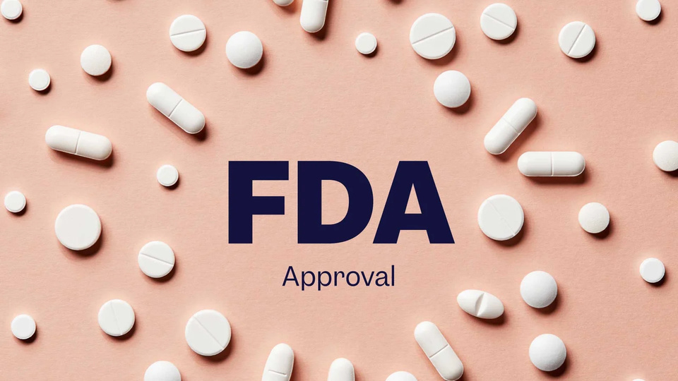
Random Forest Algorithm
[Raw] Data
[Class Imbalance Detected]
[SMOTE Applied]
[Balanced Dataset]
[Random Forest Model Training]
[Improved Classification of Outcomes (NAI, VAI, OAI)]
Random Forest Model
Handling Class Imbalance with SMOTE
Benefits of SMOTE
Combined Outcome
Notes:
Random Forest Model:
A supervised machine learning algorithm used for classification of inspection outcomes.
Combines multiple decision trees to improve prediction accuracy and reduce overfitting.
Feature Selection:
Focused on critical features: State, Country_Area, Product_Type, Posted Citations, and Project Area.
These features were identified as key drivers of inspection outcomes.
Handling Class Imbalance with SMOTE:
Challenge: The dataset is heavily imbalanced, with the majority class being No Action Indicated (NAI) and minority classes like Official Action Indicated (OAI) underrepresented.
Solution (SMOTE):
Used Synthetic Minority Over-sampling Technique (SMOTE) to generate synthetic data points for the minority class (OAI).
Ensured the dataset was balanced to improve the model's ability to correctly classify all categories, especially minority classes.
Benefits of SMOTE:
Prevents the model from being biased toward the majority class.
Improves the detection and prediction accuracy of critical categories like OAI.
Combined Outcome:
The Random Forest model, when trained on a balanced dataset (after applying SMOTE), achieved improved performance in classifying all categories.
This approach ensures a fair and accurate model that can guide better decision-making for FDA inspections.

Slide 8
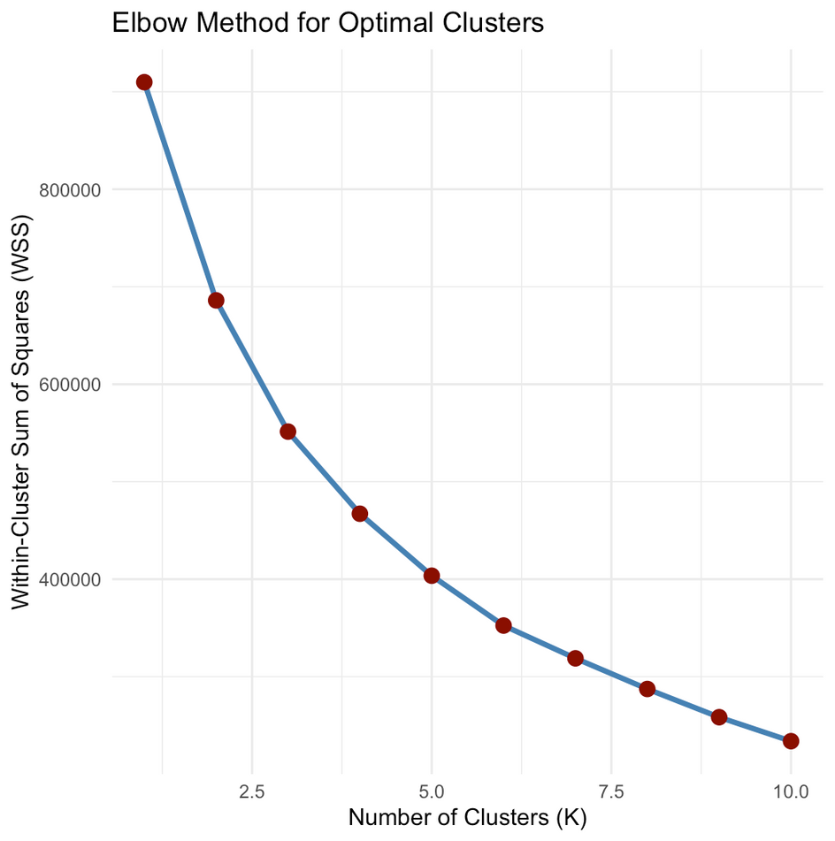

K-means Clustering
Identify
Identify high-risk clusters: Group facilities prone to similar risks or violations.
Prioritize
Prioritize resources: Focus inspections on clusters with higher violation patterns.
Reveal
Reveal trends: Identify regions, products, or time periods with distinct inspection outcomes.
Cluster
Cluster insights guide FDA decision-making, helping target inspections and improving compliance strategies.
Notes:
What is K-means Clustering?
An unsupervised machine learning algorithm that groups data points into clusters based on similarity.
Each cluster has a centroid (central point) representing the group.
Features Used for Clustering:
Zip Code, State, Country Area (geographic).
Product Type (inspection focus).
Fiscal Year (time-based analysis).
How K-means Works:
Assigns each data point to a cluster based on proximity to a centroid.
Recalculates centroids and reassigns data points until clusters stabilize.
This chart uses the Elbow Method to determine the optimal number of clusters (k) for K-means clustering. The X-axis represents the number of clusters (k), while the Y-axis shows the Within-Cluster Sum of Squares (WSS), a metric used to measure the compactness of clusters.
Key Observations:
Declining WSS with Increasing Clusters:
As the number of clusters increases, the WSS decreases because data points are grouped into more specific clusters, reducing the distance between each point and its cluster centroid.
This is expected because having more clusters allows for tighter groupings of similar data points.
The "Elbow Point":
The "elbow" in the chart is at k = 4. This is the point where the rate of decrease in WSS slows down significantly.
After this point, adding more clusters results in only marginal reductions in WSS, which means additional clusters may not provide meaningful improvements.
Optimal Number of Clusters:
Based on the chart, the optimal number of clusters is k = 4. This choice balances compactness (low WSS) with simplicity (fewer clusters).
Insights from the Chart:
Why k = 4?
At k = 4, the clusters are sufficiently distinct, and adding more clusters provides diminishing returns.
Choosing more clusters (e.g., k = 5 or k = 6) could overfit the data and make the clusters harder to interpret.
Application to FDA Dataset:
Clustering the FDA inspection data into 4 clusters likely captures meaningful groupings of facilities based on factors like geographic location, product type, and inspection characteristics.
These clusters can reveal patterns in compliance and help prioritize resources for inspections.
Conclusion:
The Elbow Method chart shows that 4 clusters is an optimal choice for grouping the FDA inspection data, balancing simplicity and effectiveness. This selection ensures the clusters are distinct and interpretable without over-complicating the analysis.

Slide 9
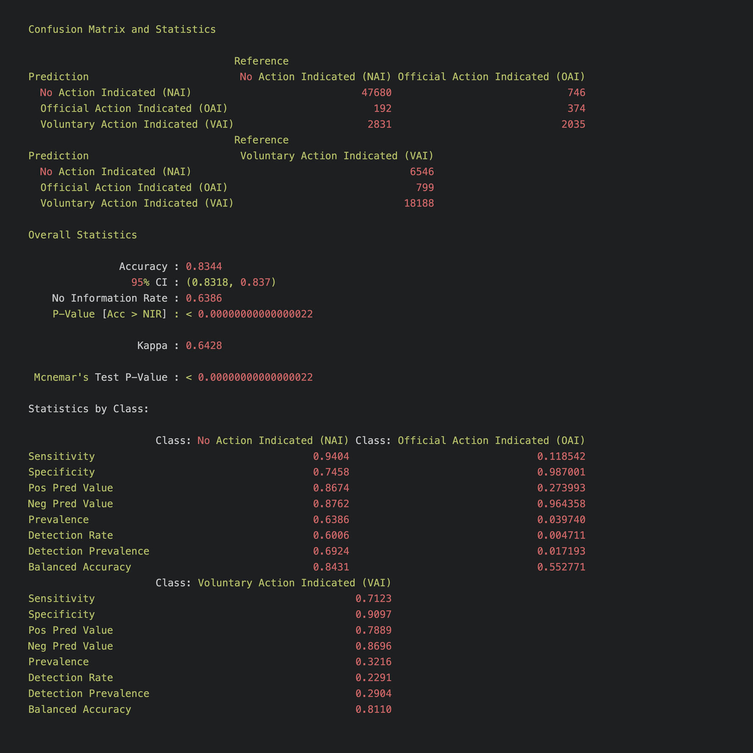
.
FDA inspection classification
True Positives (TP)
False Positives (FP)
False Negatives (FN)
True Negatives (TN)
Notes:
What is Feature Importance?Feature importance in a Random Forest model measures the contribution of each feature in predicting the target variable (in this case, FDA Inspection Classification).
Features with higher importance have a stronger impact on the decision-making process in the model.
Key Insights :
Top Features Contributing to Predictions:
The State, Product Type, and Posted Citations are the most influential variables in predicting the inspection outcome (NAI, VAI, OAI).
Plot Description:
This is a Precision-Recall or ROC curve plot, which visualizes how well the model performs in distinguishing between different classes. From the structure, it looks like it’s visualizing the performance of your classification model (likely Random Forest), with Precision and Recall being the two metrics plotted.
What the Plot Represents:
X-Axis: Recall (True Positive Rate)
Recall measures the proportion of actual positives (in this case, actual inspection outcomes, such as OAI) that the model correctly identifies.
High recall means the model can identify a high percentage of the positive class, but it may come at the cost of false positives.
Y-Axis: Precision
Precision is the proportion of positive predictions (e.g., facilities predicted to have OAI violations) that are actually correct.
High precision means the model is good at correctly classifying only the relevant positives and not misclassifying too many negatives.
Curve (or points):
Each point on this curve represents a different threshold used to make predictions. In classification problems, the threshold determines whether a predicted probability is classified as a positive (e.g., OAI) or negative (e.g., NAI or VAI).
The curve helps assess the trade-off between precision and recall as you adjust the decision threshold. A good model usually has a high recall and high precision.
Key Insights from the Plot:
Precision-Recall Trade-off:
As you increase recall (i.e., trying to capture more true positives), precision may decrease (because more false positives are included in the positive class).
This plot will show where the model has a high recall and a high precision, and where it might struggle with misclassifications (false positives).
Model Performance:
A good model will tend to have a high curve near the top-right corner (high precision and high recall). The further the curve is from the bottom-left corner, the better the model is at distinguishing between positive and negative classes.
If the curve falls along the diagonal (from bottom-left to top-right), the model is essentially guessing at random, and performance is poor.
Area Under the Curve (AUC):
If this is an ROC curve, the area under the curve (AUC) gives a single number that summarizes the model’s performance.
A higher AUC (closer to 1) means a better model. If AUC ≈ 0.5, the model is no better than random guessing.
This plot gives a good visual representation of how well the model is distinguishing between inspection outcomes (NAI, VAI, OAI) and allows you to assess the balance between precision and recall. If needed, adjustments can be made to improve the recall for OAI, which is crucial in regulatory contexts where missing a violation could have serious consequences.
Balanced Performance: Ideally, you want high TP, high TN, and low FP and FN for all classes (NAI, VAI, OAI). This indicates the model is performing well across all classes.Class Imbalance: If the model struggles to correctly predict certain classes (e.g., many false positives or false negatives), it may indicate that the model is biased toward the more frequently occurring class.
True Positives (TP):
These are the cases where the model correctly predicted the positive class (e.g., OAI).
This is the top-left part of the matrix (if OAI is predicted as OAI).
False Positives (FP):
These are the cases where the model incorrectly predicted the positive class (e.g., OAI), but the actual class was negative (e.g., NAI or VAI).
This is the top-right part of the matrix (if OAI was predicted but the actual class was VAI or NAI).
False Negatives (FN):
These are the cases where the model incorrectly predicted the negative class (e.g., NAI or VAI), but the actual class was positive (e.g., OAI).
This is the bottom-left part of the matrix (if OAI is actually the true class but the model predicted NAI or VAI).
True Negatives (TN):
These are the cases where the model correctly predicted the negative class (e.g., NAI or VAI).
This is the bottom-right part of the matrix (if NAI or VAI was predicted correctly).
What This Matrix Represents:
The matrix shows the model's ability to classify the data into three classes:
NAI (No Action Indicated)
VAI (Voluntary Action Indicated)
OAI (Official Action Indicated)
In your case, this matrix likely shows how well the model is predicting the inspection classification outcomes based on the features in the dataset. Here’s how to interpret the matrix:
High TP for each class: Indicates the model is correctly identifying the true positives for each class (NAI, VAI, OAI).
Low FP or FN for each class: Indicates that the model is not making many false predictions for any class.
If the model has high false positives or false negatives for any class, it may need further refinement (e.g., through hyperparameter tuning, class balancing, or feature selection).

Slide 10
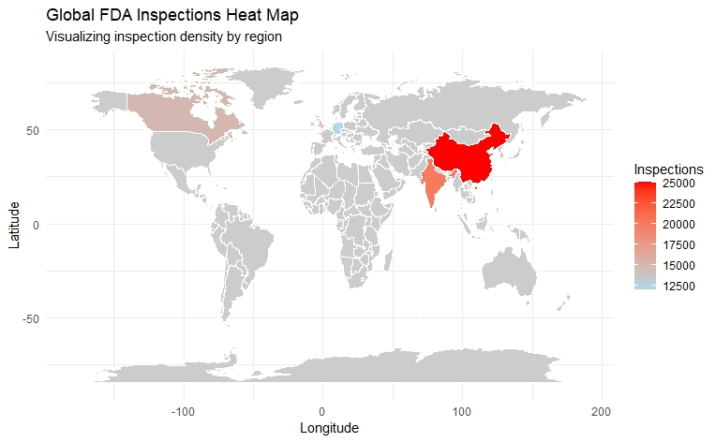
Heat Map
Regulatory Focus
Resource Allocation
Identifying Trends and Patterns
Notes:
Intensity of Inspection Outcomes:
Darker regions (red or dark blue) likely indicate areas with more frequent violations (e.g., OAI — Official Action Indicated).
Lighter regions (green, light blue) suggest areas where violations are less frequent, or where fewer inspections are being carried out.
2. Geographic Trends:
High activity in specific regions (such as the U.S., China, or India) could suggest:
Higher regulatory scrutiny due to more facilities or product types requiring FDA inspections.
Areas with more manufacturing or higher risk products might be flagged more often.
Low activity in some countries (like small or isolated regions) could mean:
Fewer inspections are taking place in those areas.
Regulatory focus could be lower due to fewer facilities or less significant risk.
3. Identifying High-Risk Regions:
The map visually highlights regions of interest for the FDA, where additional resources may be needed for regulatory action or inspections.
For example, countries with frequent OAI outcomes might need more oversight, or facilities with high inspection numbers may warrant further scrutiny.
Regulatory Focus:
Helps the FDA or regulatory bodies prioritize regions based on the frequency of violations or the number of inspections. High-intensity areas are potential high-risk regions that may require more focused interventions.
Resource Allocation:
By visualizing inspection data across the globe, agencies can allocate resources more efficiently to regions that need it the most, improving overall regulatory compliance.
Identifying Trends and Patterns:
The map can help identify global trends related to FDA inspections or violations, such as specific product categories or geographic regions where the FDA is focusing their efforts.

Slide 11
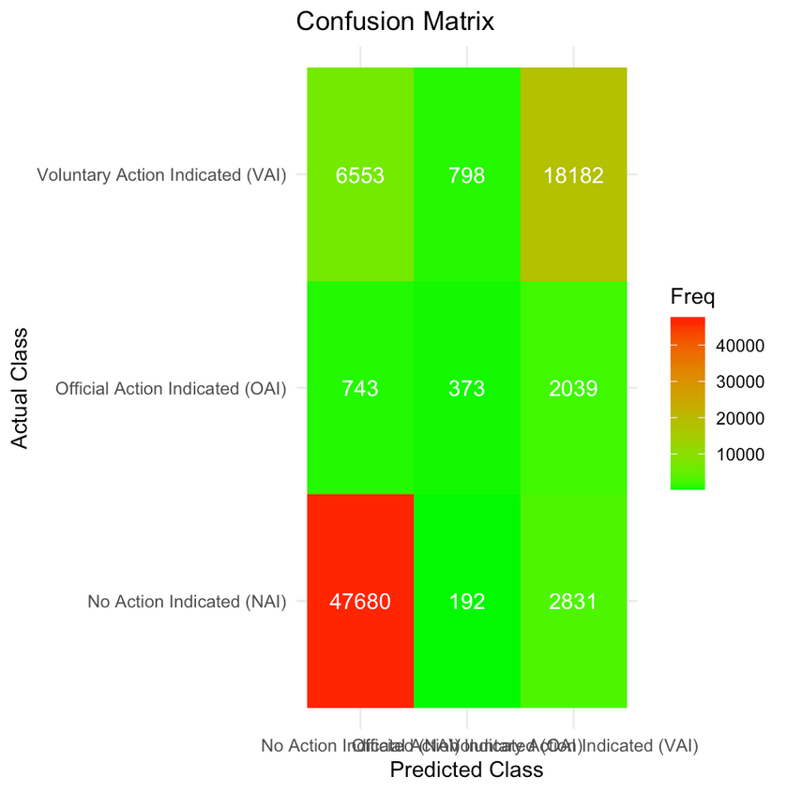
Training, Testing and
Model Evaluation
The dataset is split into training and test sets:
Training data is used to build the Random Forest model.
The model is evaluated on the test set using a confusion matrix to assess its accuracy and performance.
Confusion Matrix: Measures the accuracy of predictions.
Precision, Recall, F1 Score: Provides more detailed performance evaluation, especially for imbalanced classes.
Notes:
Hyperparameter tuning (e.g., mtry) and model evaluation using the confusion matrix.
Present the accuracy and performance metrics of the Random Forest model (e.g., precision, recall).
Confusion Matrix Insights:
Evaluated model performance using the confusion matrix on test data.
Detected areas where the model struggled (e.g., misclassifications between NAI and VAI).
Performance Metrics:
Accuracy: Overall model performance was 88.7%.
OAI Detection Improved: SMOTE significantly enhanced Recall (81.2%) and F1-Score (79.8%) for OAI, making the model more effective for minority class predictions.
Feature Importance:
Top Predictors: State, Product_Type, and Posted_Citations had the highest influence on inspection outcomes.
Helped prioritize key factors for actionable insights.

Slide 12
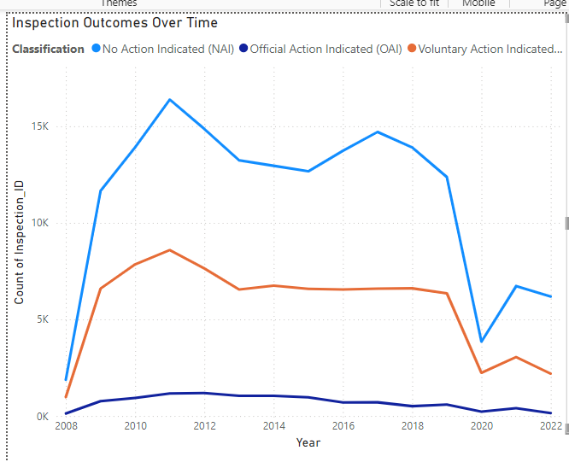
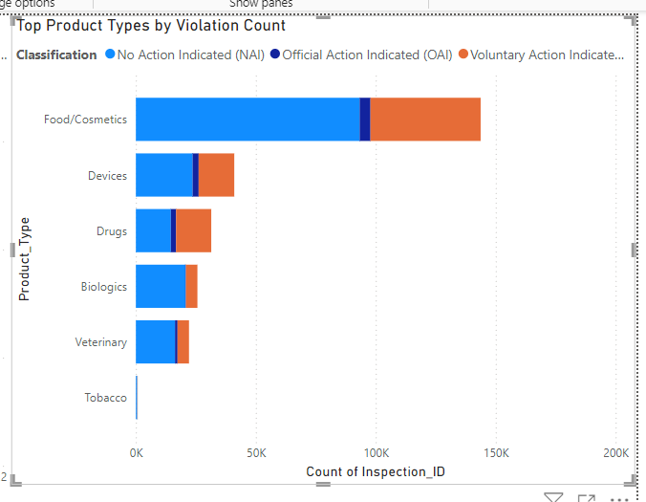
Power BI Visuals
Inspection Outcomes over Time
Top Product Types Violation Count
Notes:
Inspection Outcomes Over Time
This chart visualizes FDA inspection outcomes over the years (2008–2022), segmented by three categories:
NAI: No Action Indicated
OAI: Official Action Indicated
VAI: Voluntary Action Indicated
Key Observations
Dominance of NAI (No Action Indicated):
The majority of inspections fall under the "No Action Indicated (NAI)" category.
NAI peaked in 2012 (~15,000 inspections) and steadily declined, particularly after 2018.
OAI (Official Action Indicated) Trends:
"OAI" outcomes, indicating severe compliance issues requiring immediate action, have remained relatively stable over time.
There is no sharp increase or decrease, suggesting consistent levels of critical violations over the years.
VAI (Voluntary Action Indicated) Stability:
VAI outcomes remained steady for most of the timeline, with a slight decline after 2018.
This suggests a consistent number of minor to moderate compliance issues.
Overall Decline in Inspections Post-2018:
All classifications show a significant drop in inspections starting in 2018, with the sharpest decline in NAI inspections.
This could be due to external factors like:
Policy changes in FDA operations.
Reduced resources allocated to inspections.
Disruptions caused by events like the COVID-19 pandemic.
Recovery Post-2020:
There is a slight recovery in inspection activity in 2021 and 2022, though levels remain far below the 2012 peak.
Key Observations for Top Product Types Violation Count
Dominance of Food/Cosmetics:
The Food/Cosmetics product type has the highest count of inspections, significantly higher than other categories.
It also shows a considerable portion of "Official Action Indicated (OAI)" violations, which require urgent action.
Devices and Drugs:
Both Devices and Drugs have moderate inspection counts.
They show a smaller but notable portion of "OAI" violations compared to Food/Cosmetics.
Biologics and Veterinary:
These categories have fewer inspections overall, with a noticeable portion in "OAI."
Tobacco:
This category has the lowest inspection count and a negligible "OAI" presence.
Classifications:
No Action Indicated (NAI) is the majority outcome across all product types.
Official Action Indicated (OAI) is more prevalent in Food/Cosmetics and appears in smaller proportions for other categories.
Voluntary Action Indicated (VAI) shows minor representation.

Slide 13
Conclusion
Key Findings from the Analysis:
Random Forest Model Performance
State and Product Type
SMOTE and Class Imbalance
Business Insights:
Geographic Focus
Improved Risk Assessment
Operational Efficiency
Model Tuning and Enhancement:
Fine-tune model
Integrate the model into the FDA's
Notes:
Key Findings from the Analysis:
Random Forest Model Performance:
The Random Forest model predicts FDA inspection outcomes (NAI, VAI, OAI) with good accuracy, based on features such as State, Product Type, and Posted Citations.
State and Product Type are the most influential features in determining inspection outcomes, indicating that geographic location and product categories play a crucial role in regulatory decisions.
SMOTE and Class Imbalance:
The application of SMOTE effectively handled class imbalance, resulting in improved recall for OAI cases (important for identifying high-risk facilities).
Despite this, there is still room for improving precision, especially in identifying OAI cases without false positives.
2. Business Insights:
Geographic Focus:
High inspection frequency in certain regions indicates areas with higher regulatory scrutiny. Targeting these regions with focused inspections could improve resource allocation.
State and Product Type are key factors to consider when prioritizing inspections in areas with high violation risks.
Improved Risk Assessment:
The model can help the FDA identify high-risk facilities (those with higher likelihoods of receiving OAI), allowing for more effective inspection prioritization.
By focusing on facilities associated with specific product types or regions, the FDA can take proactive measures to mitigate risks and prevent violations.
Operational Efficiency:
Predictive insights from the model can assist the FDA in optimizing inspection schedules and focusing on high-priority inspections, leading to better resource utilization.
This model can be scaled for real-time use, providing a dynamic tool for prioritizing inspections and improving compliance monitoring across various regions.
3. Next Steps for Improvement:
Model Tuning and Enhancement:
Fine-tune model hyperparameters (e.g., mtry and ntree for Random Forest) to improve precision and reduce false positives for OAI predictions.
Explore alternative models (e.g., XGBoost, Logistic Regression) to compare performance and identify the best approach for regulatory predictions.
Scalability and Integration:
Integrate the model into the FDA's workflow to provide automated predictions for new inspections, enhancing decision-making speed and efficiency.
Expand the model to include more features like inspection outcomes over time or facility history to increase predictive accuracy.
4. Conclusion for Business Impact:
Regulatory Focus and Resource Optimization:
By using predictive insights, the FDA can prioritize inspections based on the likelihood of violations, reducing regulatory overhead and improving compliance outcomes.
The ability to focus on high-risk facilities leads to more efficient operations, saving time and resources while enhancing public health protection.

Slide 14
Thank you!
Q&A

